Slide 1
Grouping and Summarizing Data
Patrick Mathias
Lesson 6
DLMP Fall 2021

Slide 2
Goals
Learn dplyr tools for grouping and summarizing data in R
Objectives
Calculate a summary statistic for a variable using the summarize() function
Creates groupings of data using the group_by() function
Combine group_by() and summarize() functions to calculate summary statistics for groups of data

Slide 3
Typical Data Science Pipeline
From R for Data Science (https://r4ds.had.co.nz/introduction.html)
Notes:
In this session we will continue our focus on transformation and introduce some tools for basic statistics and modeling also.

Slide 4
Summarize the data set
Notes:
Let’s start by introducing the concept of summarizing with with Summarize() function.

Slide 5
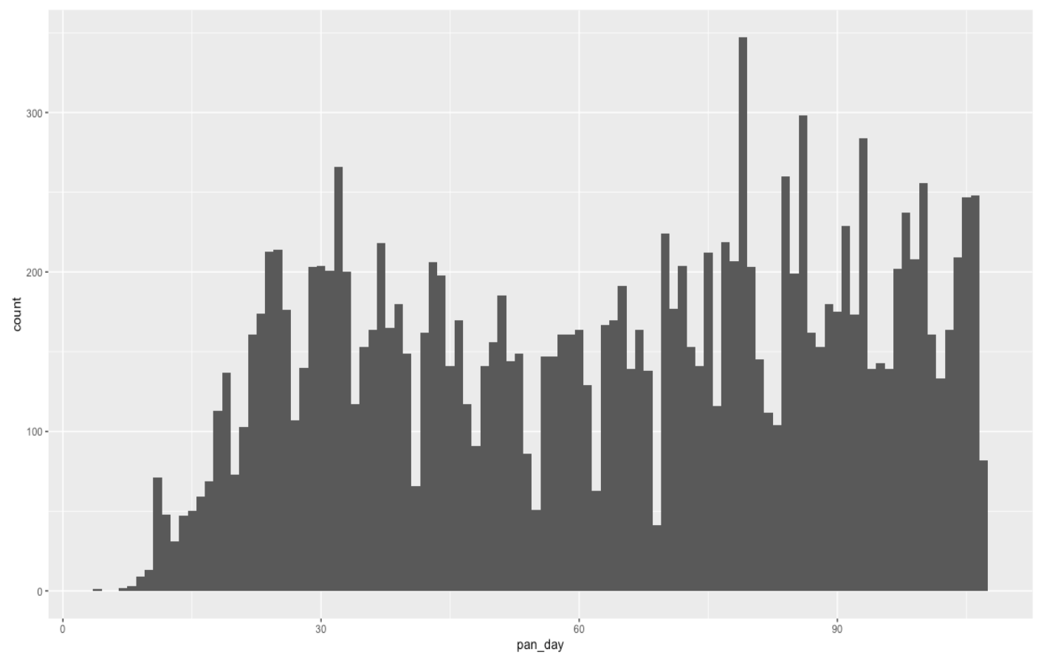
Q: How many tests are ordered per day?
Notes:
Here is a straightforward and practical question that we might ask of our data set.
How many tests are ordered per day.
This visualization represents both groupings of data (each day is a group of data) and summaries of data (each data is represented by a count of orders in that day).
Dplyr has handy functions to do both summarizing and grouping of data and we will explore them in this lesson.

Slide 6


summarize()
Make summaries of your data
Notes:
Summarize allows us to take a variable (column) of data and apply a function (or functions) to all observations.
Using summarize we can return a single value, or summary.

Slide 7
summarize()
Make summaries of your data
covid_testing %>%
summarize(new_variable = calculation)
name for new variable
Value or function
Performs calculation across all rows of data frame
Notes:
To make summaries of our data we use the following code construct.
We pass a data set using pipes to the summarize function.
Within the summarize function we provide a variable name and set it to a calculation or value that we define.

Slide 8
summarize()
function that returns number of observations
Make summaries of your data
covid_testing %>%
select(mrn, pan_day) %>%
head(4) %>%
summarize(order_count = n())
mrn | pan_day
5001412 | 4
5000533 | 7
5009134 | 7
5008518 | 8
order_count
4
Notes:
Let’s look at a simple example using summarize() to count the number of orders in a data set.
Note, that to simplify the data frame, we first will select 2 variables and include the first 4 observations.
n() returns the number of observations or rows for a data frame.

Slide 9
summarize()
function that returns number of distinct values
Additional summaries = new columns
covid_testing %>%
select(mrn, pan_day) %>%
head(4) %>%
summarize(order_count = n(),
day_count = n_distinct(pan_day))
mrn | pan_day
5001412 | 4
5000533 | 7
5009134 | 7
5008518 | 8
order_count
4
day_count
3
Notes:
n_distinct() counts the number of distinct, or unique, observations. So, while there are 4 rows, there are only 3 distinct days

Slide 10
Your Turn #1
- Open “05 – Group by and Summarize.Rmd”
- Run the setup chunk
- Fill-in gaps to calculate:
a) Mean count of orders per `pan_day`
b) Mean count of orders per clinic
Notes:
8 mins

Slide 11
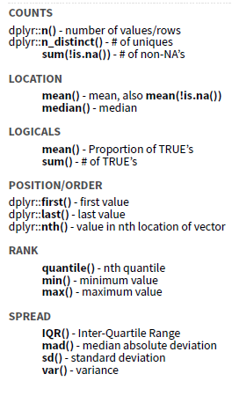
Notes:
There are many different summary functions.

Slide 12
Output the last day
covid_testing %>%
summarize(last_day = last(pan_day))
mrn | pan_day
5001412 | 4
5000533 | 7
5009134 | 7
5008518 | 8
last_day
8

Slide 13
Calculate the median turnaround time
covid_testing %>%
mutate(col_ver_tat = col_rec_tat + rec_ver_tat) %>%
summarize(col_ver_tat_mean = mean(col_ver_tat))
mrn | pan_day | col_ver_tat
5001412 | 4 | 6
5000533 | 7 | 8
5009134 | 7 | 10
5008518 | 8 | 11
col_ver_tat_mean
8.75

Slide 14
Your Turn #2
For the covid_testing data frame, calculate the median collect-to-verify turnaround time.

Slide 15

Pop Quiz
How would you calculate the median number of orders per day?
Notes:
The mean was a special case, because it can be calculated using summarize and not explicitly knowing which order is from which day. We can take the total number of orders divided by the total number of days.
But, to calculate the median (find the mid-point of the observations), we need to be able to assess each day separately.

Slide 16
Grouping your data
Notes:
To answer this question we need to be able to group data.

Slide 17
group_by()
Notes:
Group_by is a challenging function to master, but extremely powerful. It is one of those tools that once you understand how to use, you cannot possibly go back to live without it.
Group_by allows us to take a data frame and break the observations up into several groups.
Then we can “look” at those groups separately.

Slide 18
group_by()
Grouping observations based on a specific variable’s values
covid_testing %>%
group_by(variable)
name of variable to group by
Notes:
Here is the code construct for grouping.
We pass a data set using pipes to the group_by() function.
Then we specify the variable that we want to define groups.

Slide 19
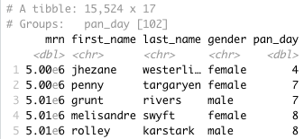
group_by()
Group observations by pan_day
covid_testing %>%
group_by(pan_day)
Notes:
Let’s look at a example of grouping by pan_day.
We can see that the resulting object has 15,524 rows that are broken up into 102 groups.
This means there are 102 distinct `pan_day`’s.
Some of these groups will have a single observation. Many of these groups will have more than one observation.

Slide 20
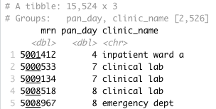
group_by()
Group observations by `pan_day` and `clinic_name`
covid_testing %>%
select(mrn, pan_day, clinic_name) %>%
group_by(pan_day, clinic_name)
Notes:
We can also group by more than one variable.
We can see that the resulting object has 15,524 rows that are broken up into 2,526 groups.
This means there are 2,526 distinct combinations of `pan_day` and `clinic_name`.
Some of these groups will have a single observation. Many of these groups will have more than one observation.
Also, not all theoretical combinations of `pan_day` and `clinic_name` exist; only 2,526 such combinations exist.

Slide 21
group_by() %>% summarize()

Slide 22
group_by()
%>%
summarize()
Make summaries of your data by group
Notes:
Just like we can apply summarize() to a full data frame, we can apply summarize() to each group separately.
The combination of group_by() and summarize() is extremely powerful.

Slide 23
group_by() %>% summarize()
Make summaries of your data
covid_testing %>%
summarize(order_count = n())
mrn | pan_day
5001412 | 4
5000533 | 7
5009134 | 7
5008518 | 8
order_count
15524
Notes:
Using summarize() without group_by() we can count how many total rows there are.

Slide 24
group_by() %>% summarize()
Make summaries of your data
covid_testing %>%
group_by(pan_day) %>%
summarize(order_count = n())
mrn | pan_day
5001412 | 4
5000533 | 7
5009134 | 7
5008518 | 8
pan_day
4
7
8
9
order_count
1
2
3
9
Notes:
Adding group_by(), we count how many rows there are for each `pan_day`.
This is the data that underlies the figure we looked at in slide 6.

Slide 25
Your Turn #3
Calculate:
a) The median turnaround time for each day
b) The median number of orders per day

Slide 26
Calculate the 95th percentile of turnaround time
covid_testing %>%
group_by(clinic_name) %>%
summarize(tat_95th_pctile = quantile(rec_ver_tat, 0.95))
clinic_name | rec_ver_tat
inpatient ward a | 4.7
clinical lab | 6.4
picu | 5.6
emergency dept | 7.1
clinic_name
clinical lab
emergency dept
inpatient ward a
picu
tat_95th_pctile
8.9
9.6
9.3
9.1

Slide 27
Count tests per day, then visualize
tmp <- covid_testing %>%
group_by(pan_day) %>%
summarize(n_tests = n())
ggplot(data = tmp) +
geom_point(aes(x = pan_day, y = n_tests)) +
geom_smooth(aes(x = pan_day, y = n_tests), method = 'loess') +
ylab("# of tests") +
xlab("Pandemic day")

Slide 28
group_by() %>% summarize(): Example
Notes:
Number of tests per day.
Points for each day.
Curve as smoothed point estimate (blue line) and confidence interval (dark gray shading), calculated using local polynomial regression (loess) with default settings.

Slide 29
Recap
Summarize() is a function that enables us to calculate summaries of variables (columns).
Common summary activities include counting observations using n(), counting unique observations using n_distinct(), and calculating means using mean().
Group_by() is a function that enables us to create subsets of data by a variable. Data can also be grouped by multiple variables.
Combining the group_by() and summarize() functions is a powerful way to look at summarizations across groups.

Slide 30
What else?

Slide 31
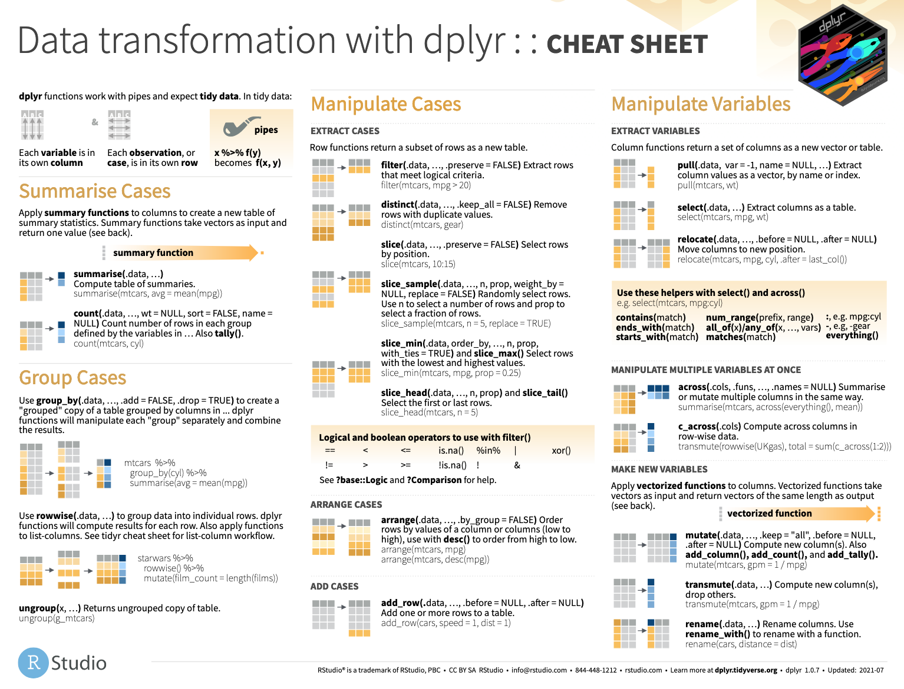
Notes:
The dplyr cheat sheet helps with the grammar of transforming data including functions functions grouping and summarizing data.
The dplyr cheat sheet is available on the RStudio website.

Slide 32
Goals
Learn dplyr tools for grouping and summarizing data in R
Objectives
Calculate a summary statistic for a variable using the summarize() function
Creates groupings of data using the group_by() function
Combine group_by() and summarize() functions to calculate summary statistics for groups of data

Slide 33

Please fill out an eval
https://forms.office.com/r/rrMn3hevpY

Slide 34
Tests for Association

Slide 35
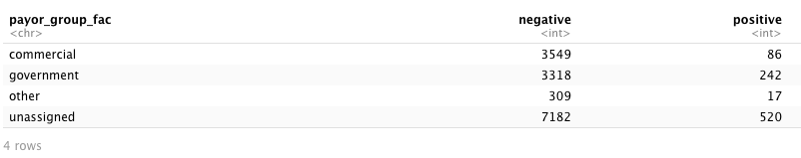
Q: Is there an association between insurance product and SARS-CoV-2 RT-PCR positivity?
data %>%
fisher.test(simulate.p.value = T)
Notes:
To ask whether the appears to be a non-random association between whether SARS-CoV-2 RT-PCR testing result is positive and a patient’s insurance product.
We need to create a table organizing our count data and then need to ask how likely is the arrangement of the table counts given that there is no association.

Slide 36
Data wrangling - 1
function that flexibly assigns values
covid_testing_2 <- covid_testing %>%
mutate(payor_group_fac = case_when(
is.na(payor_group) ~ "unassigned",
payor_group %in% c("charity care",
"medical assistance",
"self pay",
"other") ~ "other",
TRUE ~ payor_group)
) %>%
filter(result %in% c("positive", "negative"))
Notes:
The case_when() function allows us to assign payor group types to a category. In this example if no payor group is present we assign to “unassigned”, if the payor group is “charity care”, “medical assistance”, or ”self pay” we assign to other, for the remaining we assign as the provided payor group.
The filter functions limits our selection to cases where the result was ”positive” or “negative”.

Slide 37
Data wrangling - 2
# Generate counts
tmp_table_tall <- covid_testing_2 %>%
group_by(payor_group_fac, result) %>%
summarize(n = n()) %>%
ungroup()
tmp_table_tall
# Pivot from tall to wide table
tmp_table_wide <- tmp_table_tall %>%
spread(key = "result", value = "n")
tmp_table_wide
Remove groupings
Maps key values to separate columns
Maps key values to separate columns
Notes:
Here we apply grouping and spreading to achieve a data format where we have 3 columns (payor group, count of positive results, count of negative results).
See the output of this wrangling on the next slide.

Slide 38
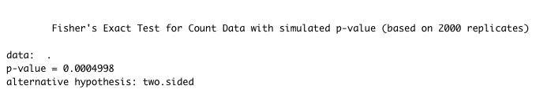
Testing for association
data %>%
fisher.test(simulate.p.value = T)
Notes:
Applying the fisher.test() function we find that payor group category as we have defined it in this example is associated with a PCR positive test result (p=0.0005).

Slide 39
Regression Modeling

Slide 40
Q: Is the association between test positivity and a government insurance product explained by the age of the patient?
tmp <- covid_testing_2 %>%
filter(payor_group_fac %in% c("commercial", "government")) %>%
mutate(result_fac = factor(result,
levels=c("negative", "positive"),
ordered=T),
payor_group_fac = (payor_group == "government"))
tmp_fit <- glm(result_fac ~ payor_group_fac + age, # model formula
data = tmp, # dataset
family = "binomial" # type of model
)
summary(tmp_fit)
exp(coefficients(tmp_fit)) # odds
Notes:
We can also apply regression modeling to our data.
glm() is a function for generalized linear models.
In this example we build a model evaluating test positivity as a function of payor group (commercial or government) and age.

Slide 41
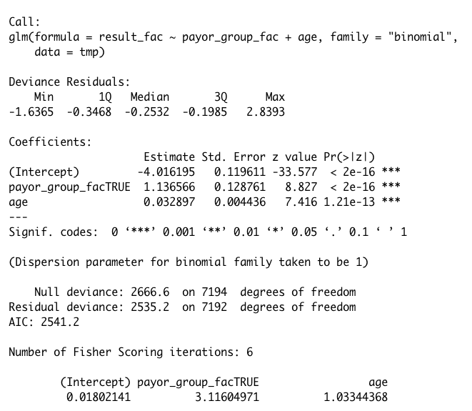
Output for logistic regression
Odds for Payor Group and Age
Notes:
Our model yields an odds ratio of 3.1 for payor group and 1.0 for age.
This suggests that the association of test positivity with government insurance product is not explained by the age of the patient.

